Slide 1


Does the job fit you? Here's why.
A job search copilot that explains your fit, drafts documents you approve and tracks every application.
MARKET
LAUNCH (PLANNED)
MVP
Germany · DE / EN
14 June 2027
Candidate app + headhunter pilot
Ironhack AI Product Management · Mini Project 1 · demo with illustrative data
Notes:
Title. One line: CareerPilot tells job seekers whether they fit a job and why.

Slide 2


One mark, one promise: hit your target role
Intro
PRD
Backlog
Wireframes
Integration
Demo
Close
01 · INTRODUCTION · BRAND
Navy
Mist
#0F2A4A · Primary · 60%
#E8EEF6 · Secondary · 30%
Flare
Muted
#F2542D · Accent · 10%, graphics only
#5B6B80 · Text and lines
Logo A, the reticle wordmark
The "o" in Pilot is a target. The orange dot is your target role, and it doubles as the credit icon in the app.
Inter, ExtraBold for the wordmark
Calm, honest, neutral: one accent, no sponsored badges, every paid action shows its cost before the click.
Chosen from three directions; research on Confluence.
Notes:
CareerPilot, logo A: the reticle wordmark. The orange dot is your target role and the credit icon. Navy, mist and one orange accent; Inter. The brand promises calm and neutral: nothing is sponsored.

Slide 3
Lena applies a lot and still can't tell where she fits
Intro
PRD
Backlog
Wireframes
Integration
Demo
Close
01 · INTRODUCTION · THE PROBLEM
40+
applications sent
01
02
Noisy vacancies
Unclear fit
The same searches on several boards, ads that all sound alike.
No answer to "do I qualify?", so she applies blindly or not at all.
3
interviews
03
04
Rewriting every time
Losing track
5
job boards checked every morning
A new CV and cover letter for each ad, by hand.
Which job, which CV, which date: nothing in one place.
Persona figures are illustrative composites from ideation, not measured data.
Notes:
Meet Lena. 24, master's in Leipzig, 40+ applications, 3 interviews. Five boards every morning, same question each time: do I actually qualify? Boards rank by who paid, CV tools tell her which keywords to copy. She applies blindly or talks herself out of jobs, and loses track of where she applied.

Slide 4




Four people, one question: is this a fit?
Intro
PRD
Backlog
Wireframes
Integration
Demo
Close
01 · INTRODUCTION · PERSONAS
CANDIDATE · SENIOR
CANDIDATE · GRADUATE
CANDIDATE · EXPAT
HEADHUNTER · PILOT
Markus
Lena
Andrei
Sofia
Senior systems engineer, Stuttgart, 18 years in automotive
M.Sc. Business Informatics, Leipzig, 2 internships
Data engineer, Munich, works in RO / EN / DE
Verified recruiter hiring in Germany
About 60 alerts a week; wants only roles worth his time
Needs to know which roles she qualifies for, and why
Needs the required language level and real employers only
Wants available candidates with ≥ 90% fit, without CV databases
Personas are illustrative composites, still to be validated in 15 candidate and 5 headhunter interviews.
Notes:
Lena isn't alone. Markus: 60 alerts a week, no time for 59. Andrei: three languages, needs the real language requirement, has met fake recruiters. Sofia, a verified headhunter, wants available candidates who really fit her client's job, without trawling CV databases.

Slide 5
Today's tools optimise wording or volume, not fit
Intro
PRD
Backlog
Wireframes
Integration
Demo
Close
01 · INTRODUCTION · COMPETITION
Keyword scores reward copying the ad
↑ Focused decisions
Jobscan and Teal compare your CV's words with the ad's.
Auto-apply trades quality for volume
CareerPilot
JobCopilot applies for you; you don't choose each job.
Jobscan
Trackers record, they don't advise
← Keyword wording
Explained fit →
Huntr organises applications but doesn't say where you fit.
Teal
Huntr
Boards rank what is paid for
Job boards
Sponsored ads and premium tiers shape what you see first.
JobCopilot
↓ More applications
Nobody tells you whether a low score means "you don't fit" or "we lack data".
Map positions are our assessment. Prices and details: appendix.
Notes:
Jobscan compares wording, so you score higher by copying keywords. Teal similar, plus a tracker. Huntr tracks, doesn't advise. JobCopilot applies for you: volume, not choice. Job boards rank what is paid for. None separates a real fit gap from missing data. That's our gap.

Slide 6
The PRD defines what we build and why
Intro
PRD
Backlog
Wireframes
Integration
Demo
Close
02 · PRD · THE FOUNDATION
PROBLEM
12
31
Job seekers can't tell whether they fit a job. Searches are fragmented, rankings are paid for, and no tool explains a score (P1–P7).
chapters, from problem to legal
functional requirements
SOLUTION
14
29
One digest from public job lists, a free explained match score, preparation tools paid with credits, documents the user approves, one application history.
non-functional requirements
user stories with criteria
TARGET USERS
3
2
Job seekers in Germany (Markus, Lena, Andrei) and, in an invitation-only pilot, verified headhunters (Sofia).
methods: MoSCoW, RICE, WSJF
child pages: score, completeness
Confluence · CareerPilot – MVP PRD · source of truth for every other artefact
Notes:
The PRD on Confluence is our foundation and source of truth: problem, solution, target users, 31 functional and 14 non-functional requirements, 29 user stories with acceptance criteria, prioritised with MoSCoW and RICE, plus WSJF for the pilot. Two child pages explain the score and profile completeness; chapter 12 covers what a real pilot needs legally.

Slide 7
Three stories carry the core of the product
Intro
PRD
Backlog
Wireframes
Integration
Demo
Close
02 · PRD · KEY USER STORIES
US2 · MARKUS · MUST
US3 · LENA · MUST
US4 · LENA · MUST
How my score is built
A score that reflects fit
One application history
As a selective job seeker, I want to see how my match score is calculated and why the job fits, so that I can reject or pursue a role in seconds.
As a recent graduate, I want my score to reflect my fit, not my missing profile data, so that I know which roles I really qualify for.
As an active applicant, I want every application logged with date, source, documents and the job description, so that I never apply twice.
ACCEPTANCE
ACCEPTANCE
ACCEPTANCE
Each criterion shows its weight and contribution, and they add up to the score. No sponsored label, no paid boost.
An incomplete profile still gets scores with a confidence label. A score under 70% names its cause: fit gap or missing data.
Confirming "Did you apply?" creates the entry with the saved job description. Reopening an applied job shows a warning.
FR7 · FR19 · FR23 · CPA-24
FR7 · FR18 · FR19 · CPA-25
FR11 · CPA-26
Notes:
Three stories carry the product. US2: Markus sees how the score is built, and nothing is sponsored. US3: Lena's score reflects fit, not missing data. US4: every application lands in one history with the job description. Each story links to its requirements and its Jira key.

Slide 8
Every point of the score has a reason you can see
Intro
PRD
Backlog
Wireframes
Integration
Demo
Close
02 · PRD · KEY DECISION: THE MATCH SCORE
Six criteria, fixed weights
92%
CV–job fit
Match = Σ weight × fit. Skills are mapped to the EU ESCO taxonomy, so copying keywords doesn't help.
High confidence
Data analyst · Example Systems. Illustrative score, not a hiring probability. How it's calculated
Must-haves cap, never hide
An unmet must-have caps the score 1 point below your minimum fit (90% → 89%). The job stays visible with the reason.
Required skills
35%
33.4
Relevant experience
25%
21.7
Completeness sets confidence
Role / title
15%
13.7
A thin profile still gets scores; it lowers the label and we name the missing fields.
Education
10%
8.2
Languages
10%
10.0
A score is not a hiring probability
Location
5%
5.0
No age, gender, nationality, photo or other protected attributes are used.
Illustrative demo job · weights published, not yet validated
Notes:
Each score is a weighted sum of six criteria: skills 35, experience 25, role 15, education 10, languages 10, location 5. The points add up to the score. An unmet must-have caps the score just below your minimum fit, but the job stays visible. Completeness never hides scores; it sets confidence. Not a hiring probability.

Slide 9
9 epics and 29 stories, each traced to the PRD
Intro
PRD
Backlog
Wireframes
Integration
Demo
Close
03 · BACKLOG · STRUCTURE
CPA-2
CPA-3
CPA-4
MoSCoW sets the scope
Profile & Onboarding
Job Discovery
Explainable Matching
22 candidate stories: 13 Must, 6 Should, 2 Could, 1 post-MVP.
5
3
4
RICE ranks within it
Reach × impact × confidence ÷ effort. Matching without a gate scores highest (800).
CPA-5
CPA-6
CPA-8
Application Documents
3
Application History
2
Trust & Privacy
3
WSJF for the pilot
7 headhunter stories, ordered by dependencies; capacity decided at G2.
CPA-78
CPA-88 · PILOT
CPA-89 · PILOT
Career & Interview
2
Headhunter Matching
5
Consent & Availability
2
Same template everywhere
Persona, FR reference, Given / When / Then criteria, epic link.
Jira · project CPA · board 39 · number = stories per epic
Notes:
The backlog in Jira mirrors the PRD: 9 epics, 29 stories. MoSCoW sets the scope, RICE ranks inside it, WSJF orders the 7 pilot stories. Every story has a persona, its FR references and Given/When/Then acceptance criteria.

Slide 10
Six build sprints, 79 story points, alpha on 2 April 2027
Intro
PRD
Backlog
Wireframes
Integration
Demo
Close
03 · BACKLOG · SPRINT PLAN
SPRINT 1
SPRINT 2
SPRINT 3
SPRINT 4
SPRINT 5
SPRINT 6
Profile
Discovery
Matching
Fit & privacy
Documents
Tracking
11–22 Jan
25 Jan–5 Feb
8–19 Feb
22 Feb–5 Mar
8–19 Mar
22 Mar–2 Apr
US8 CV to profile
US9 Completeness
US1 One digest
US14 Preferences
US2 Explained score
US6 Language level
US3 Fit, not missing data
US12 My data
US17 Confidence
US5 CV and letter
US10 Credits
US22 What's free
US4 History
US11 Reminders
US20 Language
US21 Apply + confirm
13 pts
13 pts
13 pts
13 pts
13 pts
14 pts
Before: S1–S6 validate and design (Oct 2026 – Jan 2027). After: hardening and Should stretch (US18 interview prep, US7, US15, US16, US19), beta in May, launch 14 June 2027.
Notes:
Six build sprints in Jira, 11 January to 2 April 2027, 79 points, about 13 per sprint for 2 engineers and an ML engineer. Each sprint has a goal. Before them we validate and design; after them we harden, try the Should stories, run the beta in May and launch on 14 June.

Slide 11
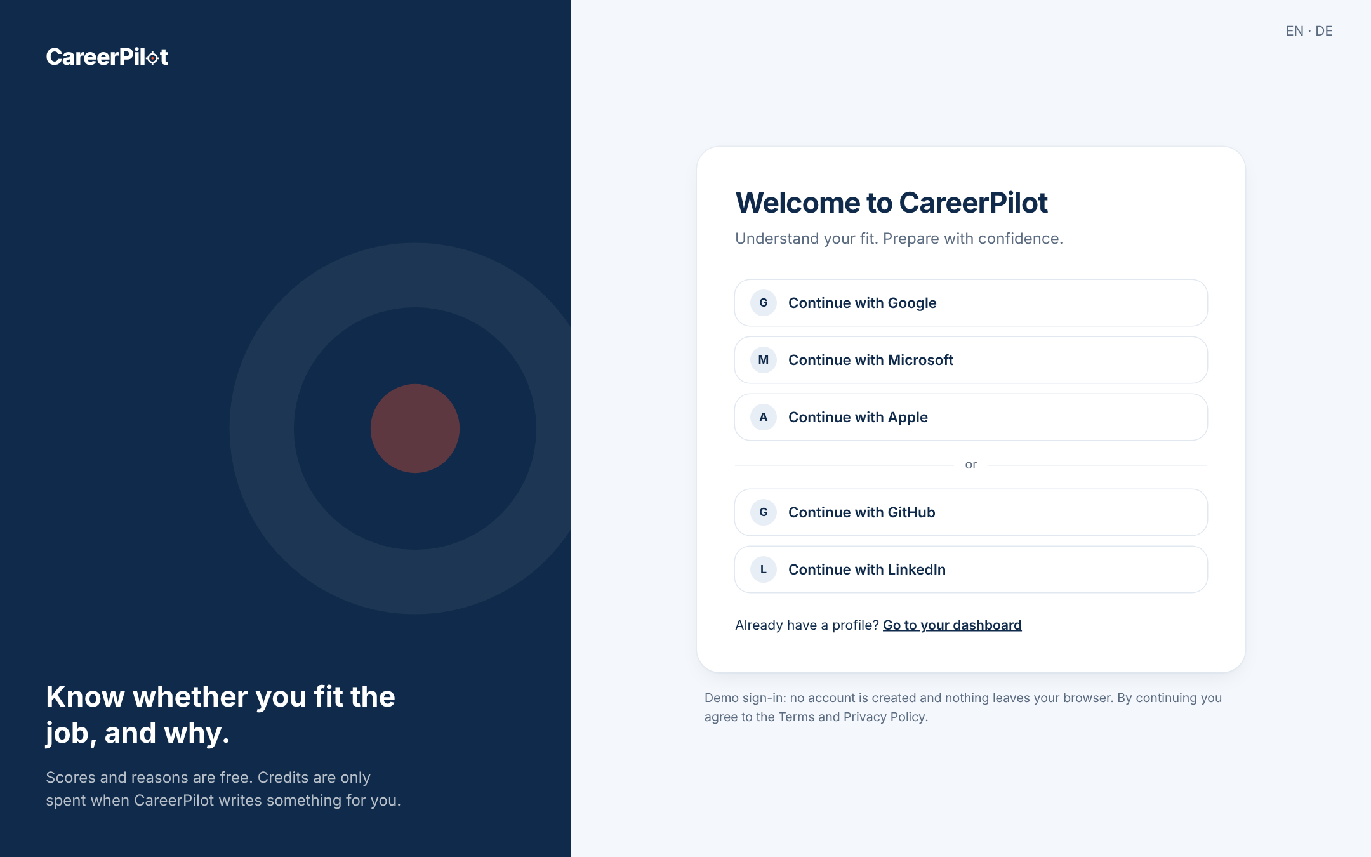
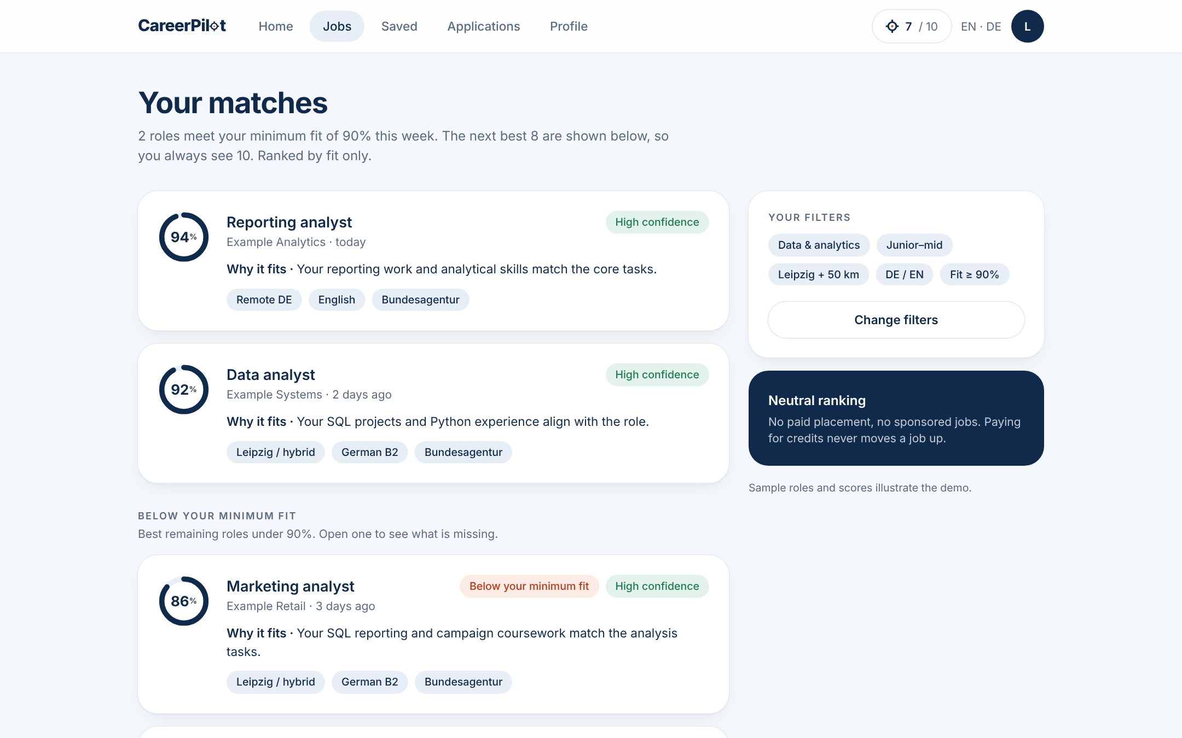
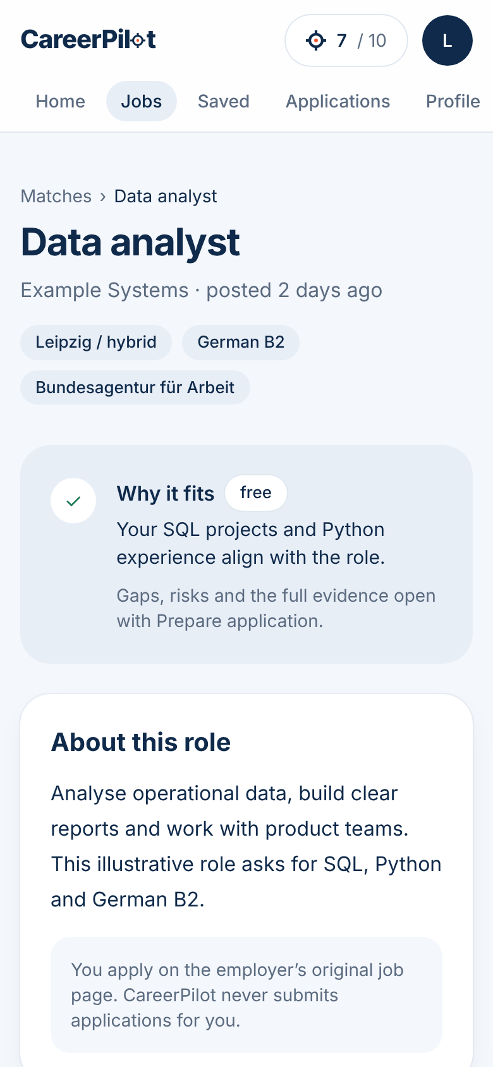
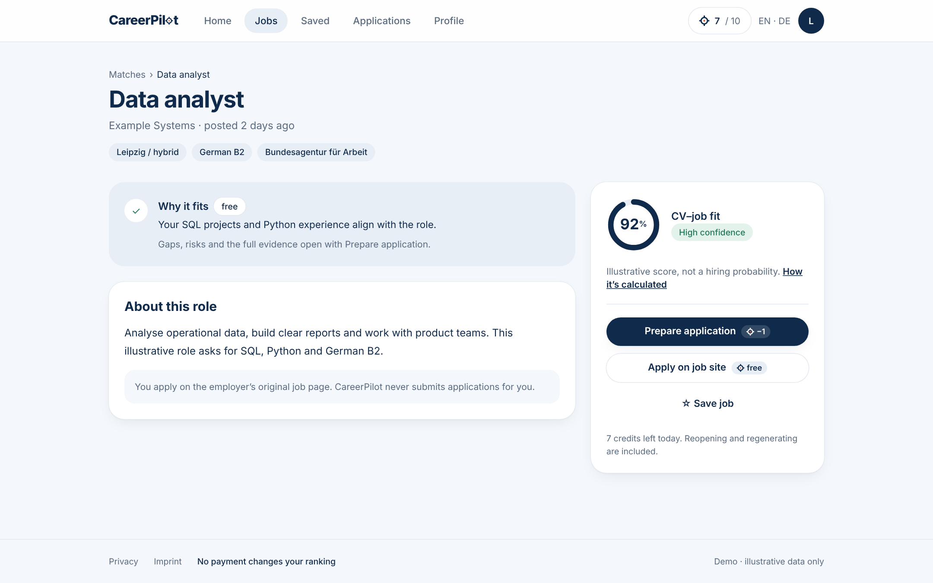
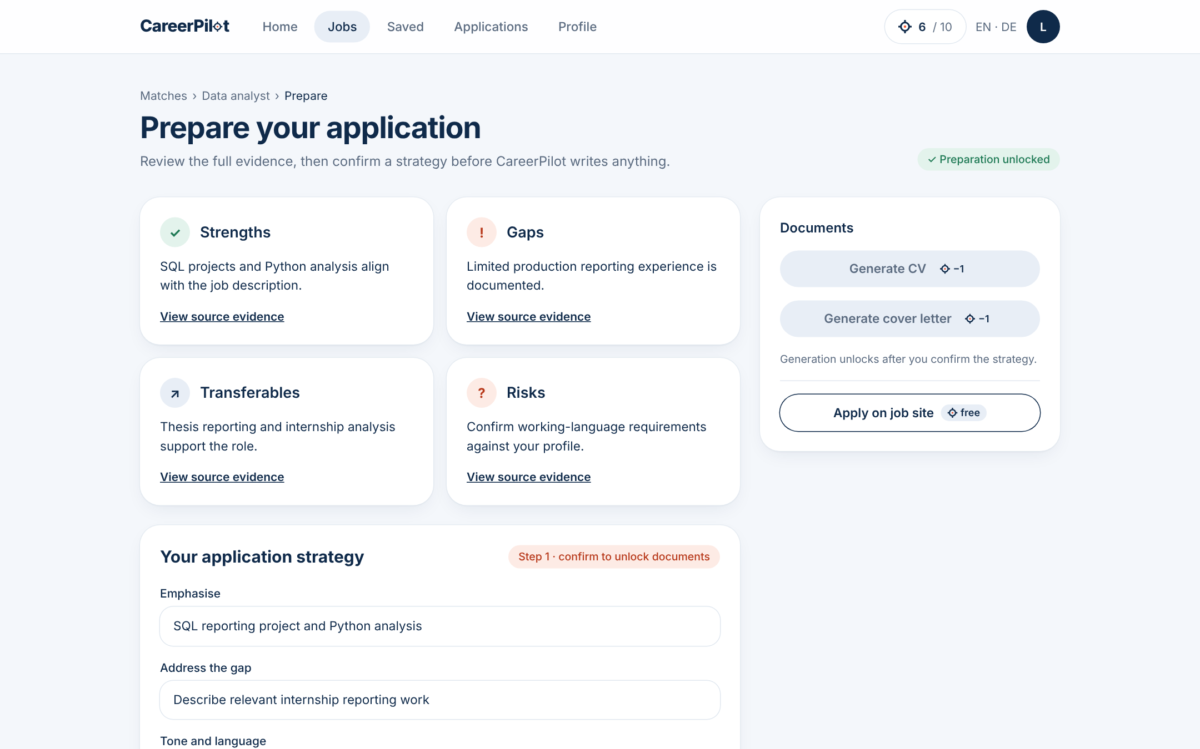
Seven screens in one clickable flow, on web and mobile
Intro
PRD
Backlog
Wireframes
Integration
Demo
Close
04 · WIREFRAMES · FIGMA PROTOTYPE
1 SSO sign-in
›
2 Onboarding
›
3 Alerts & filters
›
4 Job list
›
5 Job focus
›
6 Preparation
›
7 History
1 · SSO card (Figma Community)
4 · Job list: 10 jobs, fit ring
Mobile frame 390 × 844: the job focus
Built from Figma Community parts (SSO card, wireframes kit) in the logo A style. Each frame names the user stories it covers.
5 · Job focus: Prepare, Apply, Save
6 · Preparation: evidence, strategy
Figma · CareerPilot prototype · screenshots from the demo built from it
Notes:
The wireframe plan on Confluence specified seven screens; Figma turned them into a clickable flow, reusing community components for the SSO card and the wireframes kit, plus one mobile frame of the job focus. Every frame names the stories it covers.

Slide 12
One thread from problem to demo, for every feature
Intro
PRD
Backlog
Wireframes
Integration
Demo
Close
05 · INTEGRATION · HOW IT FITS TOGETHER
Problem
PRD
Jira
Wireframe
Demo
P3 · Unclear fit
›
FR18, FR19 · no gate, explain the cause
›
US3 · CPA-25 · Sprint 4
›
Job list · score view
›
/jobs · /score
P6 · Paid rankings
›
NFR1, FR23 · neutral, why it fits
›
US2 · CPA-24 · Sprint 3
›
Job focus · ranking note
›
/jobs/data-analyst
P2 · Too much to do alone
›
FR24, FR9, FR10 · prepare, approve
›
US5 · CPA-27 · Sprint 5
›
Preparation page
›
/prepare · /cv
P5 · Losing track
›
FR11, FR13 · history, interview prep
›
US4 · CPA-26 · Sprint 6
›
Application history
›
/applications
Confluence is the source of truth: a decision lands in the PRD first, then Jira, Figma and the demo follow.
Notes:
This is how the three components fit together. Every problem from ideation becomes a requirement in the PRD, a story in a Jira sprint, a frame in Figma and a route in the demo. Four threads as examples. When a decision changes, the PRD changes first and the rest follow.

Slide 13
What we decided, and what it costs us
Intro
PRD
Backlog
Wireframes
Integration
Demo
Close
05 · INTEGRATION · DECISIONS AND TRADE-OFFS
No completeness gate
Public job lists only
Free matching, paid prep
Every profile gets scores and 10 jobs; completeness sets confidence.
Bundesagentur für Arbeit lists, Apply opens the original ad, no scraping.
Score and why it fits are free; credits pay for preparation tools.
Trade-off: Some scores show with low confidence.
Trade-off: Coverage risk; checked per persona at G1.
Trade-off: 10 credits a day limit heavy users.
Interview prep after applying
Headhunter pilot, gated
Germany, DE / EN first
Offered from the application history, when it matters.
Invitation only, candidate consent for every CV share.
Prove extraction and documents in two languages.
Trade-off: Should; first to cut if time runs short.
Trade-off: Low reach; capacity decided at G2.
Trade-off: Spain waits until after launch.
Notes:
The key decisions and their costs: no completeness gate, public job lists only, free matching with paid preparation, interview prep after applying, a gated headhunter pilot, and Germany first.

Slide 14
From CV to a confirmed application in one flow
Intro
PRD
Backlog
Wireframes
Integration
Demo
Close
06 · LIVE DEMO
1
SSO sign-in
2
CV → profile at 72%
3
Preferences, min. fit 90%
4
10 jobs, 2 above 90%
5
How it's calculated
6
Prepare (−1)
7
Tailored CV (−1)
8
Apply + confirm
9
Interview prep
Next.js demo on Vercel · Figma prototype as backup · all jobs and scores are illustrative
Notes:
Demo script in the narrative doc: 9 steps, about 2 minutes. Say once that all data is illustrative. If short on time, skip step 9.

Slide 15
What we learned, and where we go next
Intro
PRD
Backlog
Wireframes
Integration
Demo
Close
07 · CONCLUSION
What we learned
What we'd do differently
Next steps
One source of truth saves rework: PRD first, then Jira, Figma and the demo
Decisions ripple: dropping the completeness gate touched every artefact
AI speeds up drafting; every number and claim still needs checking
Talk to real job seekers before fixing thresholds like 90% fit
Keep one change log so all artefacts update together
Start Figma from community components on day one
15 candidate and 5 headhunter interviews
Test the score against 100 expert-labelled profile–job pairs
Engineering estimate and legal review at G2, 8 Jan 2027
Does the job fit you? Here's why.
Notes:
What we learned, what we'd do differently, and what comes next. Close on the tagline: does the job fit you? Here's why. Thank you.

Slide 16
Everything is linked and open to view
Intro
PRD
Backlog
Wireframes
Integration
Demo
Close
07 · CONCLUSION · DELIVERABLES
PRD
Confluence · CareerPilot – MVP PRD (12 chapters, 29 stories)
Score model
Confluence · Calculating the Matching score
Backlog
Jira · CPA board (9 epics, 29 stories, 6 sprints)
Wireframe plan
Confluence · CareerPilot – Wireframe Plan
Prototype
Figma · CareerPilot prototype
Demo and code
GitHub · cugetare/CareerPilot (Next.js demo, deployed on Vercel)
Before submitting: open each link in a private window to check view access.
Notes:
All deliverables are linked here and open to view: PRD and score model on Confluence, backlog on Jira, wireframe plan, Figma prototype, and the code and demo on GitHub and Vercel.

Slide 17
Matching is free; credits pay for preparation
APPENDIX · BUSINESS MODEL
10
4
< €0.01
COMING SOON
Top up credits
free credits per user per day
credits to fully prepare one application
AI cost target per fully prepared application
Prepaid wallet, top-up from €10
10 credits for €0.99
Bought credits never expire
Action | Cost
Match score, why it fits, how it's calculated | Free
Apply on job site, save a job | Free
Prepare application (gaps, risks, strategy) | 1 credit
Tailored CV · cover letter | 1 credit each
Interview prep, from the application | 1 credit
LATER
Employers pay for job ads and talent search, behind an employer login.
Credits buy preparation tools, never a better ranking.
Notes:
Investor-funded MVP, free within 10 credits a day. Matching, why it fits, how it is calculated and applying on the employer site are always free. Credits pay for the tools that make an application stronger: Prepare (fit analysis and strategy), CV, cover letter and interview prep, one each, so fully preparing one application is 4 credits. After launch: top up a prepaid wallet from €10, 10 credits for 99 cents, never expire. Cost target under 1 cent per fully prepared application. Later employers pay for ads and talent search. Credits never buy ranking.

Slide 18
A match is an invitation; the candidate decides
APPENDIX · HEADHUNTER PILOT
1 Verified recruiter
Identity and organisation checked by an admin
Candidate control
2 Authorised job description
Must-haves and start date confirmed
Approves each CV share, per recruiter and job
Access expires and every view is logged
Can revoke discovery at any time
No bulk export, no automatic decisions
3 Opted-in candidates only
Discovery is off by default
4 Fit ≥ 90% and completeness ≥ 90%
Must-haves met, high confidence
5 Available now
Confirmed in the last 7 days
No match? An honest empty list. Thresholds are never lowered.
6 Explained, pseudonymised shortlist
No CV or contact details yet
Pilot work is estimated at G2 (8 Jan 2027); it never delays the candidate launch.
Notes:
Invitation-only pilot. Verified headhunters submit an authorised job description and get an explained shortlist of opted-in candidates with at least 90% fit and confirmed availability. No CV until the candidate approves that recruiter and that job. Empty result is allowed; we never lower 90%.

Slide 19
Germany first, public launch on 14 June 2027
APPENDIX · SCOPE AND TIMELINE
Validate
Design
Build
Beta
Launch
Oct 26
Nov
Dec
Jan 27
Feb
Mar
Apr
May
Jun
G1
G2
Alpha
G3
G4
Launch
27 Nov
8 Jan
2 Apr
30 Apr
28 May
14 Jun
IN THE MVP
NEVER, AT ANY STAGE
Germany, German and English, on web and mobile browsers
Bundesagentur für Arbeit public job lists, no scraping
Explained matching, reviewed CV and cover letter, history
Invitation-only headhunter pilot
Auto-apply or bulk applications
Paid boosts or earlier alerts that change the ranking
Sharing a CV without the candidate's approval
Automatic hiring or rejection decisions
After launch: employer login (job ads, talent search, partner feeds), credit top-ups, then a second market · Team: 2 eng., 1 ML, 1 PM
Notes:
Validate until November: 15 interviews, scoring prototype. Design until January with legal review. Build January to April, alpha 2 April. Closed beta in May with about 500 users. Public launch 14 June 2027, fixed by investors. Cut scope, never the date.

Slide 20
The score has to predict interviews
APPENDIX · SUCCESS METRICS
2×
≥ 90%
≥ 50%
< €0.01
interview rate for applications in the ≥ 90% band vs. < 70%
of matches rated accurate by users
of users still active in week 4
AI cost per complete application at scale
Targets, not results. Reviewed after a four-week beta baseline; full list in the appendix.
Notes:
Above all: applications in the 90%-plus band should reach interviews at least twice as often as those below 70%. Then trust, week-4 retention, and cost under one cent.

Slide 21
Competitors at a glance
APPENDIX · COMPETITION
Tool | What it does | Price (Oct 2026) | Gap vs. CareerPilot
Jobscan | Match rate of CV vs. ad, keyword-based | $49.95 / month · 5 free scans a month | Optimises wording; no fit vs. missing-data split
Teal | CV builder, keyword matching, job tracker | Free · Teal+ $29 per 30 days | Keyword matching, no explained fit score
Huntr | Job tracker, tailored CVs, basic match score | Free · Pro $40 / month | Records applications, doesn't advise where to apply
JobCopilot | Auto-applies to matched jobs | From $0.93 / day | Volume over fit; no review of each application
Job boards (LinkedIn, StepStone, Indeed) | Listings, alerts, premium insights | Free · paid premium tiers | Sponsored and premium visibility; no explanation
CareerPilot | Explained fit, reviewed documents, tracking | 10 free credits a day · €0.99 / 10 credits (coming soon) | —
Sources: Huntr, Teal and JobCopilot pricing pages; Jobscan via The Interview Guys review (2026). Prices in USD as listed, checked 8 Oct 2026.

Slide 22
Measurement targets
APPENDIX · METRICS
Metric | Target, 3 months after launch | Note
Application-to-interview rate | ≥ 20% overall · ≥ 90% band at least 2× the < 70% band | Main proof that the score works
Score trust | ≥ 90% rated accurate · ≥ 60% explanation-to-decision | Thumbs on evidence points
Profile completeness | ≥ 90% of new users reach 90% within 7 days | Quality signal, not a gate
Retention | Week 4 ≥ 50% · week 12 ≥ 35% | Hired users count as success
Abandonment | < 25% before first scored match · < 20% unexported documents | Find the drop-off stage
AI cost | < €0.01 per complete application at scale | Tracked from alpha
Pay-as-you-apply interest | ≥ 20% "Coming soon" clicks among users at 0 credits | Fake-door signal
All targets are assumptions, reviewed after a four-week beta baseline. Headhunter pilot: 100% eligibility compliance, zero unauthorised disclosures.

Slide 23
What a real pilot would need
APPENDIX · LEGAL
GDPR and BDSG
EU AI Act
Legal basis per use, DPIA, data protection officer, EU hosting, deletion that reaches logs and backups
Recruitment AI is high-risk (Annex III) from 2 Dec 2027; candidate-side use needs specialist classification
Anti-discrimination (AGG)
Automated decisions
No protected attributes or proxies; bias tests with the four-fifths rule
The candidate always decides; recruiter ranking keeps a human in the loop
Job data
Wallet
Bundesagentur terms of use, no scraping, mock data labelled
Through a licensed payment provider; prices incl. VAT, withdrawal rules
Not legal advice. Details in PRD chapter 12 on Confluence.

